Slide 1

WORLD HAPPINESS REPORT
Surya V
20-02-2025
Data analytics & Data science
Oct 2024

Slide 2


PROJECT OVERVIEW
The objective of world happiness report is to measure and understand global happiness by analysing factors that contribute to well-being.
Creating Dashboard.
Insights and recommendation.

Slide 3
DATASET OVERVIEW
Life Ladder- People rate their lives on a scale from 0 to 10.
Log GDP per Capita- Economic measure while reducing scale effects.
Healthy Life Expectancy at Birth - The expected number of years a newborn can live in good health.
Freedom to Make Life Choices- People feel they have the freedom to make their own life decisions.
Generosity - A measure of charitable giving and willingness to help others, often based on donation behavior.
Perceptions of Corruption- How people perceive corruption in their country.
Positive Affect -Positive emotions, such as happiness and laughter.
Negative Affect- Negative emotions, such as worry and sadness.

Slide 4
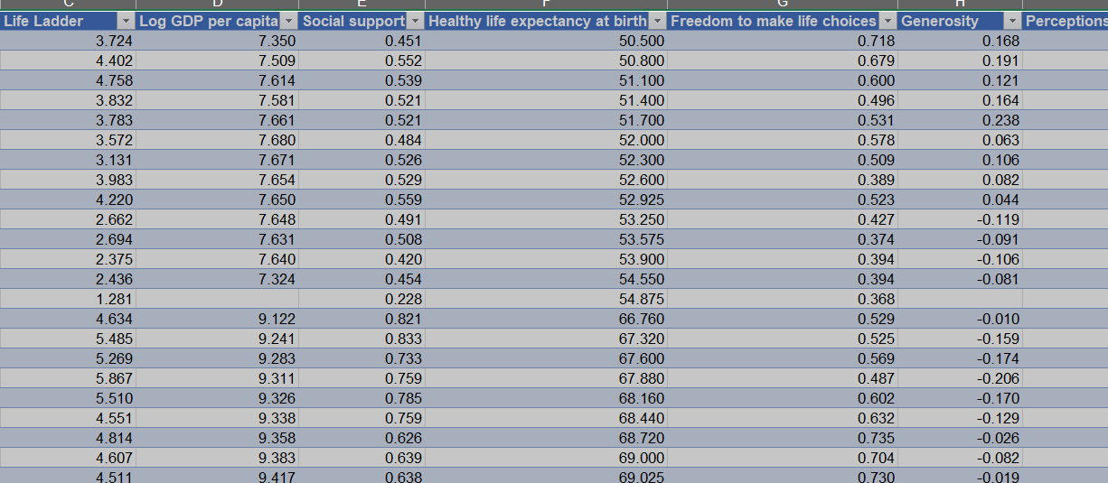
DATA CLEANING:
Cleaned the dataset using Power Query.
Handled missing values.
Inconsistent values.
Standardized data types.

Slide 5
DAX FUNCTIONS:
Aggregation: SUM(), AVERAGE(), COUNT().
Logical : IF().
Filtering: FILTER().
Rankx , Calculate Dax functions..

Slide 6
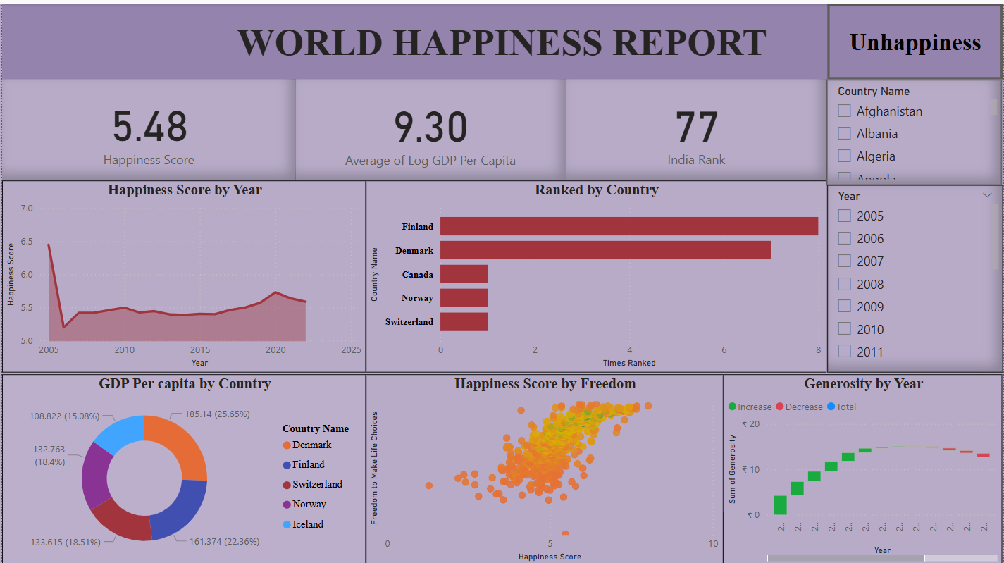
DASHBOARD

Slide 7
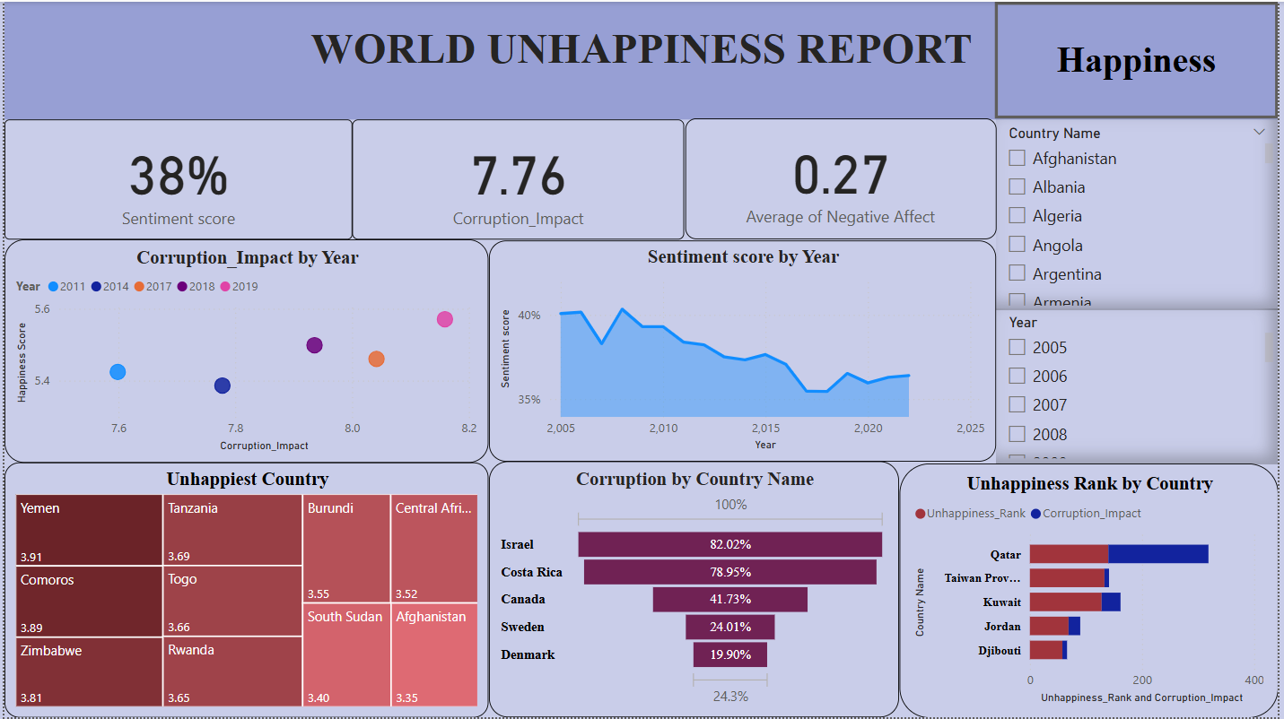
DASHBOARD

Slide 8
INSIGHTS:
Happiest Countries: Finland, Denmark, Sweden
Income & Happiness: Higher income = More happiness
Freedom & Happiness: More freedom = Higher happiness
Generosity Trends: Changes with the economy
Corruption & Happiness: More corruption = Less happiness (Score: 7.76)
Unhappiest Countries: Yemen, Tanzania, Burundi, Afghanistan
Global Happiness: Mostly stable over time
Sentiment Decline: Life satisfaction is dropping
Corruption Impact: High in Israel, Costa Rica, Canada; low in Nordic countries

Slide 9
Finland, Denmark, and Sweden are the happiest.
Higher income leads to more happiness.
More freedom equals higher happiness.
Generosity changes with the economy.
More corruption means less happiness (Impact Score: 7.76).
Yemen, Tanzania, Burundi, and Afghanistan are the least happy.
Global happiness has stayed mostly the same.
Global sentiment is declining, showing lower life satisfaction.
Corruption impact is high in Israel, Costa Rica, and Canada but low in Nordic countries.
INSIGHTS:

Slide 10
RECOMMENDATION:
Addressing Social-Economic inequalities.
Improve healthcare and education.
Promote Generosity & Social cohesion.
Reduce corruption and Improve Governance.
Promote freedom & mental Well-being.
Boost Economic opportunities.
Encourage Education and Lifelong Learning.

Slide 11
Thank You

